Slide 1
Training Networks Using Multiple GPUs

Slide 2
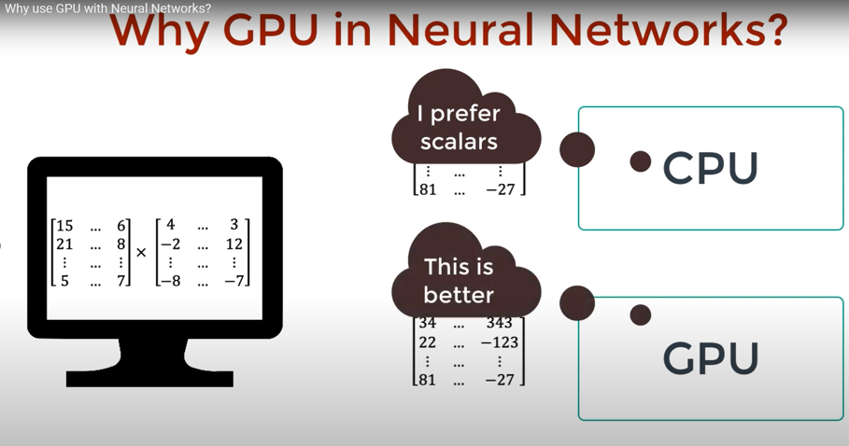
Understanding GPU Acceleration

Slide 3
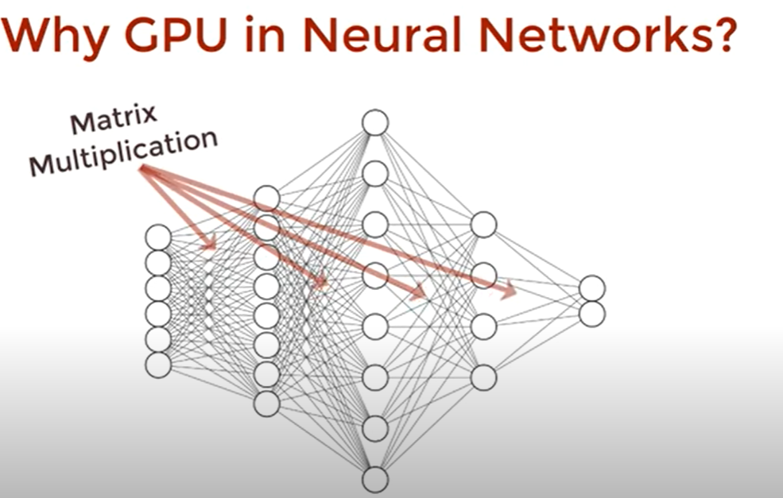
Understanding GPU Acceleration

Slide 4
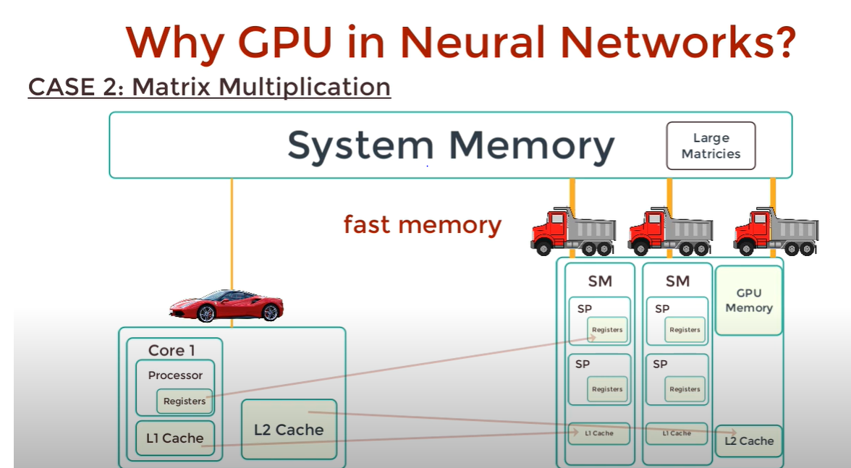
Understanding GPU Acceleration

Slide 5
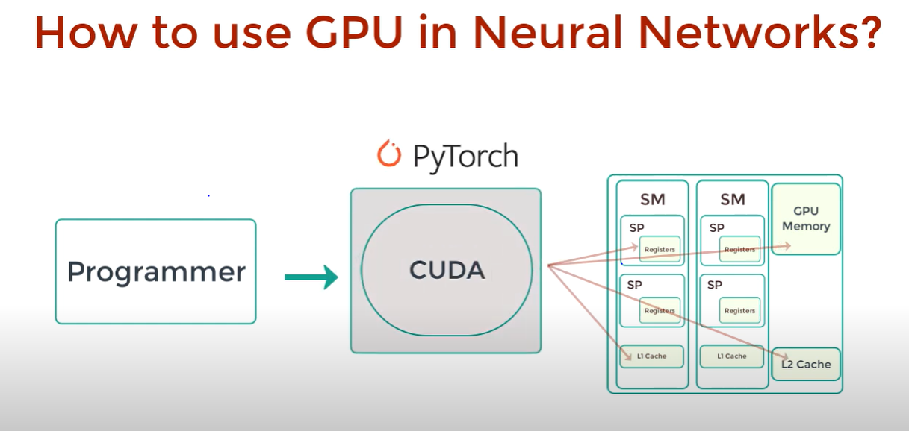
DEEP LEARNING FRAMEWORK

Slide 6
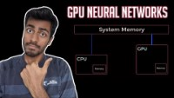
EXECUTION CODE

Slide 7
DEEP LEARNING FRAMEWORK
Registers and caches in GPUs are critical for optimizing the performance of parallel computations. Registers are small, fast storage spaces.
Caches store frequently accessed data to reduce memory access latency.
Efficient use of registers and caches is key to achieving high throughput in GPU computing.

Slide 8
DEEP LEARNING FRAMEWORK
In GPU computing, latency is often associated with the time it takes to fetch data from memory or perform a specific computation.
In GPU computing, throughput is often measured in terms of the number of operations or tasks that can be performed per unit of time

Slide 9
DEEP LEARNING FRAMEWORK
The importance of latency and throughput depends on the specific requirements of the AI application. Some applications prioritize low latency (e.g., real-time inference), while others focus on high throughput (e.g., training large models on large datasets).

Slide 10
FLOATING POINT
Floating-point operations involve arithmetic operations (addition, subtraction, multiplication, division) with numbers represented in a floating-point format.

Slide 11
Floating-point format
S (Sign Bit): 1 bit
E (Exponent Field): 8 bits
F (Significand/Mantissa): 23 bits

Slide 12
Components of the FLOPS Equation:
Components of the Equation:
GPU PERFORMANCE = Number of Operations×Clock Frequency×Number of Cores×Operationper Cycle

Slide 13
Components of the FLOPS Equation:
Number of Operations:
  This depends on the specific operation being performed. For example, in the context of deep learning, a common operation is the multiply-accumulate (MAC) operation in matrix multiplication.
Clock Frequency:
  It is the speed at which the processor operates, measured in Hertz (cycles per second)

Slide 14
Components of the FLOPS Equation:
Number of Cores:
  In parallel computing architectures like GPUs, the number of cores represents the parallel processing units available.
Operations per Cycle:
  This refers to the number of operations a processor can execute in a single clock cycle. Modern processors often have multiple execution units, allowing them to perform multiple operations simultaneously.

Slide 15
Gpu in CNN
Number of MAC Operations:
  In a CNN, most of the computation comes from convolutional layers, which involve multiply-accumulate (MAC) operations.
  The number of MAC operations depends on the size of the input feature map, the size of the convolutional kernel, and the number of output channels.
  For a convolutional layer, the number of MAC operations per output element is kernel_size^2×input_channels
Clock Frequency:
  The clock frequency is the speed at which the GPU operates, measured in Hertz (Hz).
  It represents the number of clock cycles the GPU can perform in one second.

Slide 16
Gpu in CNN
Factor of 2:
  The factor of 2 accounts for the fact that each MAC operation involves one multiplication and one addition
  FLOPS=2×MAC operations per output element×clock frequency.

Slide 17
Numerical Example
Certainly, let's dive into a more detailed numerical example with specific values for MAC operations per output element and clock frequency.
Assume we have a GPU with the following specifications:
MAC (Multiply-Accumulate) operations per output element: 44 (just as an example)
Clock Frequency: 2.02.0 GHz (2.0 billion cycles per second)

Slide 18
Numerical value
Now, plug these values into the FLOPS equation:
FLOPS=2×MAC operations per output element×Clock FrequencyFLOPS=2×MAC operations per output element×Clock Frequency
FLOPS=2×4×2.0 GHzFLOPS=2×4×2.0 GHz
FLOPS=2×4×2.0×109 operations per secondFLOPS=2×4×2.0×109 operations per second
FLOPS=16×109 operations per secondFLOPS=16×109 operations per second
The general form of a MAC operation is given by the equation:
Accumulator=Accumulator+(Operand_1×Operand_2)Accumulator=Accumulator+(Operand_1×Operand_2)

Slide 19
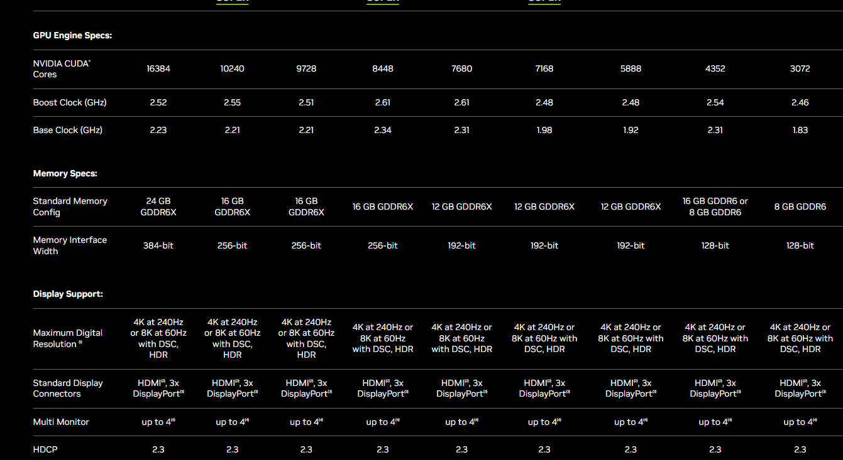
NVIDIA

Slide 20
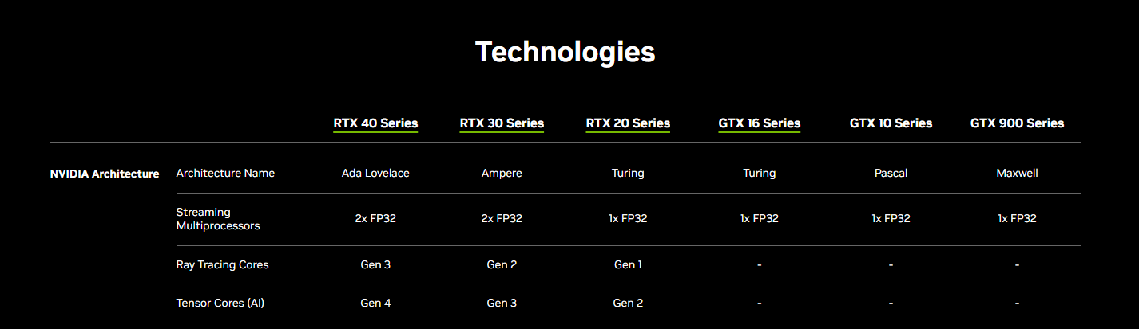
NVIDIA

Slide 21
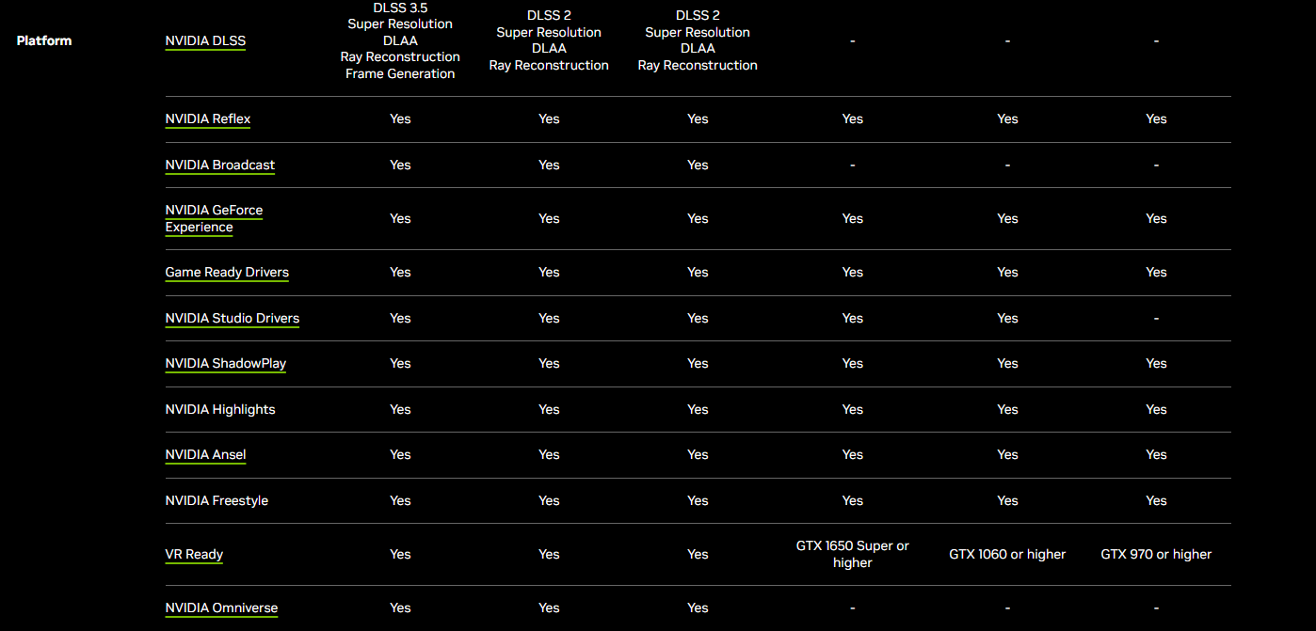
NVIDIA

Slide 22
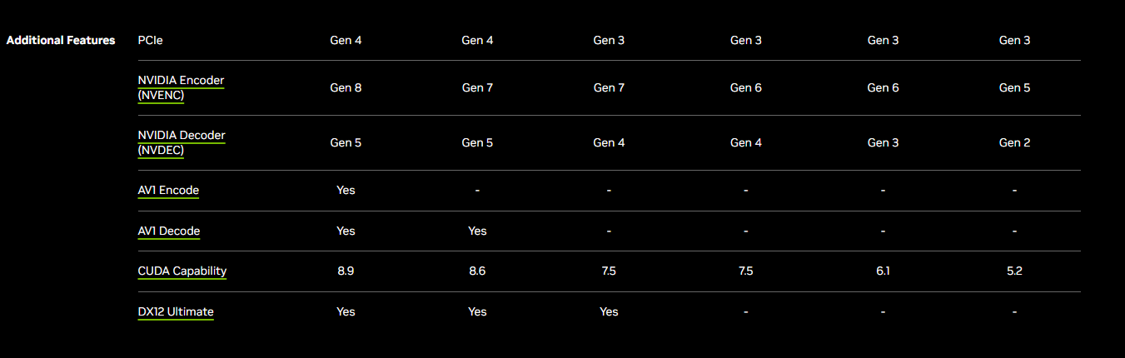
NIVIDIA

